Slide 1
Employee Performance Tableau Project
Bharti
MABSPG23012

Slide 2
About Project
The employee performance and productivity dataset, encompasses 8000 rows of data capturing key aspects of employee performance, productivity, and demographics in a corporate environment.
It includes details related to the employee's job, work habits, education, performance, and satisfaction.
To analyze the dataset, Tableau was used for visualization as well as data transformation.

Slide 3
Business Problem
Identifying Training Effectiveness
Which training programs are the most effective in boosting employee performance and satisfaction?
Will Increase in Salaries can Further Increase Performance & Satisfaction Scores?
Is there a relation between change in salaries and change in performance & employee satisfaction scores.
Does Promotion & Years at Company Impact Performance & Satisfaction Scores?
Is there any correlation between performance and satisfaction scores of the employees. Is there a pattern between all of them?

Slide 4
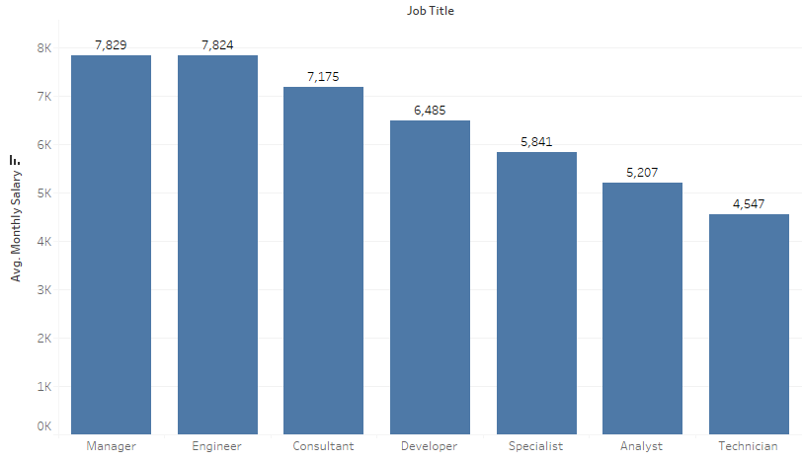
Average Salary Based on Job Tile
Managers have the maximum average salary of all the job titles.
They are followed by engineers and consultants.

Slide 5
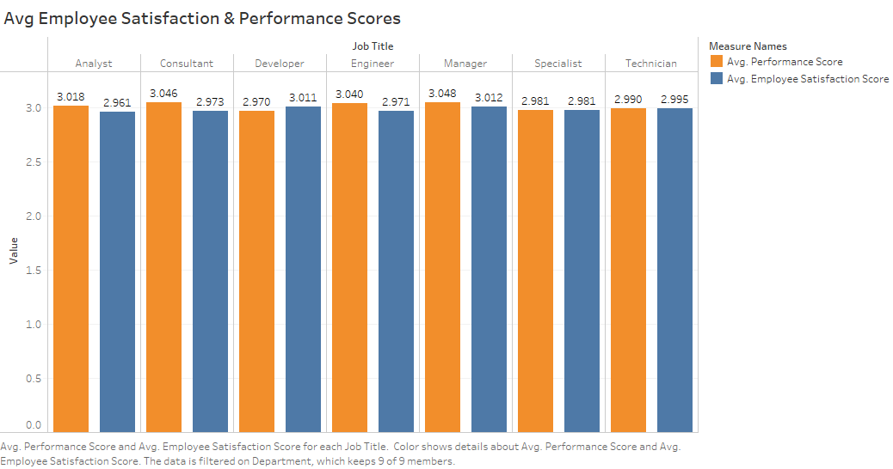
Average Employee Satisfaction & Performance Scores
Managers have the highest average employee satisfaction scores as well as highest performance scores.
Followed by consultant in terms of average performance score and developer in terms of average employee satisfaction scores.
These results differ from department to department.

Slide 6
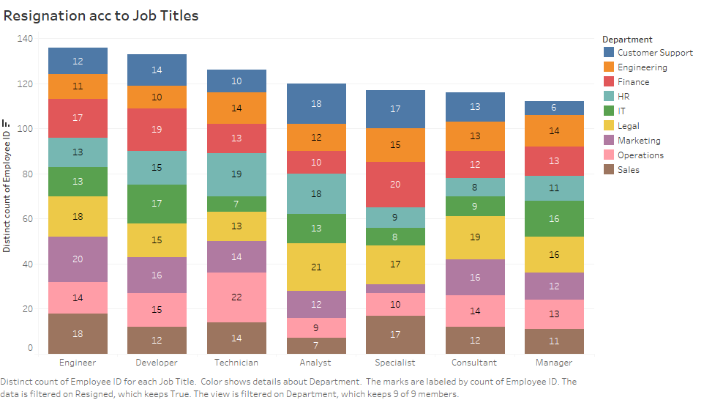
Resignation According to Job Title & Departments
In terms of department Legal have the highest number of resignations.
In terms of job titles, engineers have the highest number of resignations followed by developers and technicians.
Analyst from Legal department have the highest resignation i.e. 21 employees.

Slide 7
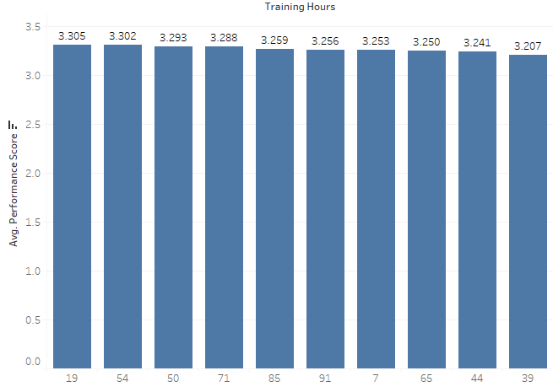
Average Performance According to Training Hours
Employees with 19 hours of training have the highest performance scores followed by 54 hours and 50 hours.
This shows there is no clear correlation between training hours and performance scores.
High training hours does not guarantee higher performance.

Slide 8
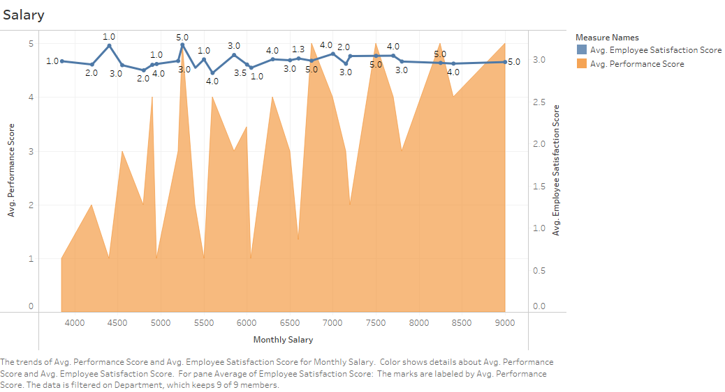
Salary Relationship
There seems no correlation between monthly salary and employee satisfaction score or performance score. There is no particular pattern between the salary and other scores.
Scores are fluctuating even when the salary is increasing.
This shows no direct relationship like more salary is equal to more employee satisfaction

Slide 9
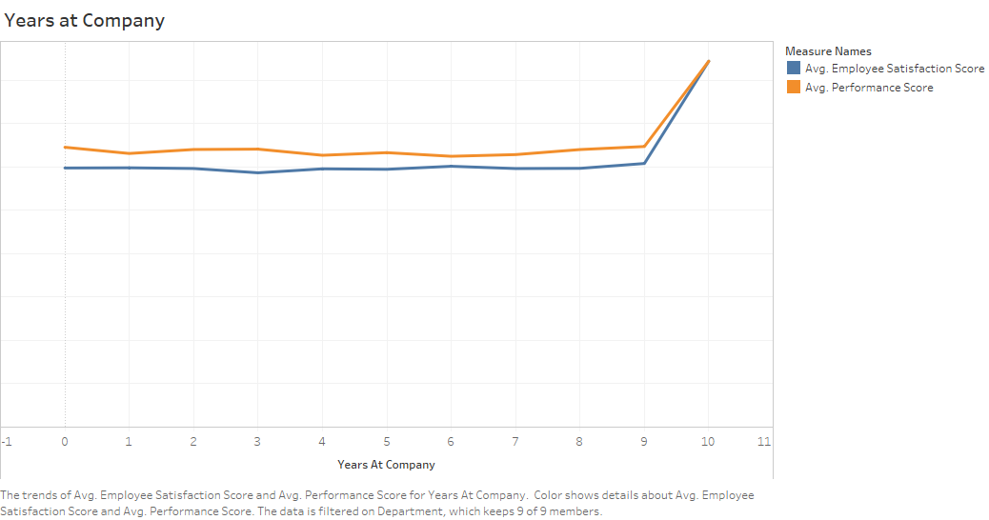
Years at Company Relationship
The key insight that can be generated from this graph is that both employee satisfaction and performance scores increases rapidly after 9th year.
employees with 9+ years of tenure benefit from a combination of increased experience, role clarity, stability, and recognition, which contribute to both higher performance and greater job satisfaction.

Slide 10
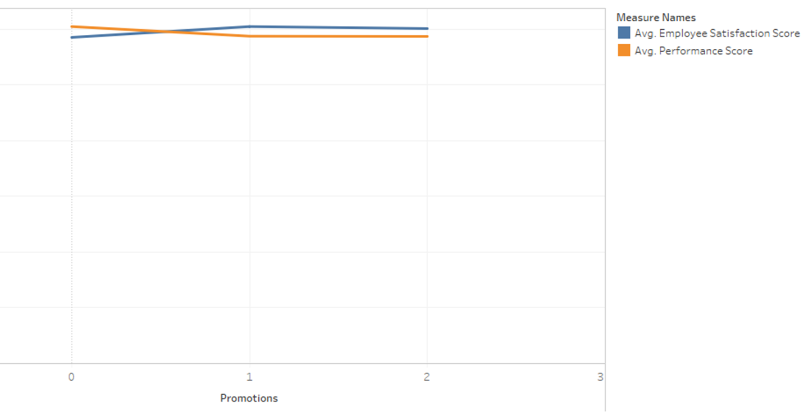
Promotion Relationship
As the number of promotion increases from 1 to 2 the employee satisfaction score increases whereas performance scores decreases.
Role change and new responsibilities might be the reason for the same

Slide 11
Recommendations
Optimize Training Hours: Identify and focus on the optimal number of training hours that maximize performance, avoiding excessive training beyond this threshold.
Tailor Training Programs: Customize training based on employee tenure and roles, offering basic training for new hires and advanced development for long-tenured employees.
Provide Support for Promotions: Offer additional support, like mentoring and leadership training, to employees after promotions to maintain performance during role transitions.
Leverage Long-Tenure Insights: Develop retention strategies targeting employees at the mid-point of their careers (5-9 years), focusing on growth and recognition to boost satisfaction earlier.
Use Data for Continuous Improvement: Continuously analyze employee performance data to refine training programs and allocate resources to areas with the highest impact on performance.

Slide 12
THANK YOU!!!!

